Slide 1
BERT: Pre-training of Deep Bidirectional Transformers for Language Understanding
Devlin et. al., 2018 (Google AI Language)
Manav Mehra

Slide 2
Outline
Motivation
Main Ideas
BERT
Experiments
Conclusion

Slide 3
Motivation
Language Model Pre-training has been shown to improve many NLP tasks which include both sentence-level and token-level tasks.
Existing Techniques-
ELMo
OpenAI GPT
ULMFit
The existing strategies for applying pre-trained language representations to down stream tasks include,
Feature-based
Fine-tuning
Notes:
Feature – based: Uses task-specific architectures that include the pre-trained representations as additional features (ELMo)
Fine – tuning: Introduces minimal task-specific parameters, and is trained on the downstream tasks by simply fine-tuning all pre-trained parameters. (Movie sentiment example – train the model to learn what movie review language looks like then in the end help it understand and predict between good and bad)

Slide 4
Problem Statement
The major limitation is that standard language models are unidirectional which limits the choice of architectures that can be used during pre-training.
OpenAI GPT uses left-to-right architecture
ELMo concatenates forward and backward language models
Solution - BERT: Bidirectional Encoder Representations from Transformers.
Notes:
In OpenAI GPT every token can only attend to previous tokens in the self-attention layers of the transformer.
Such restrictions can be very harmful when applying fine-tuning based approaches to token level tasks such as question-answering where it is crucial to incorporate context from both directions.

Slide 5
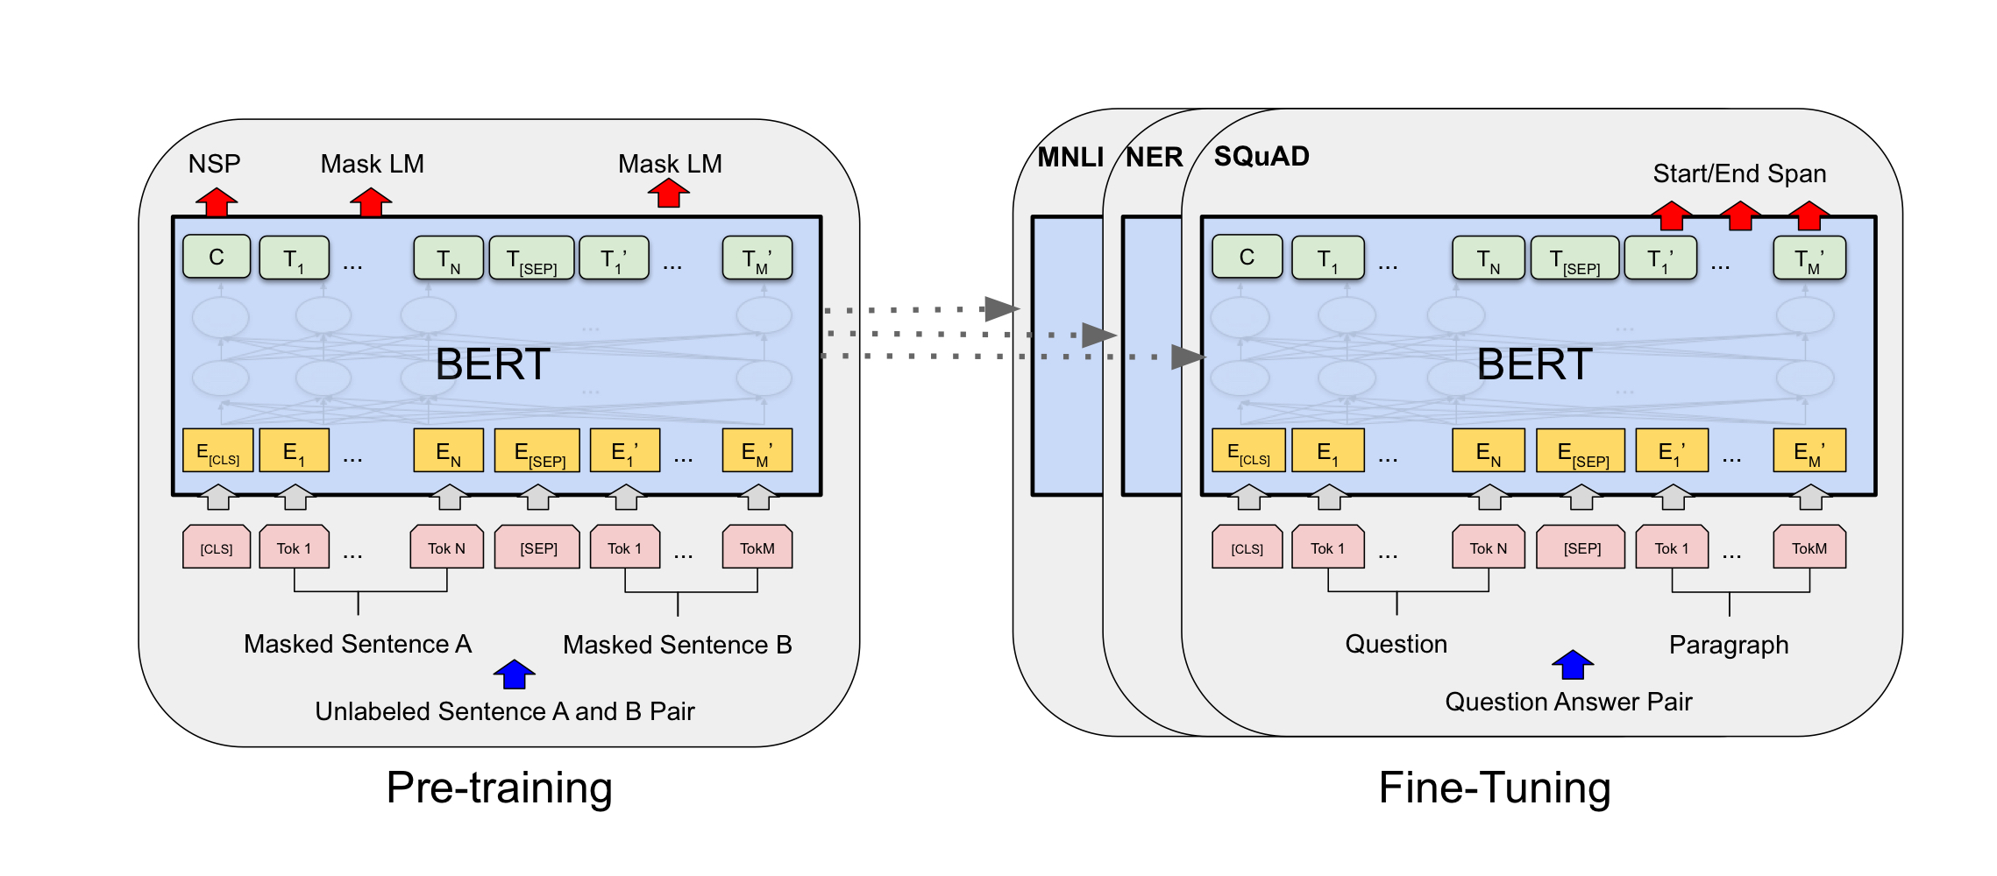
BERT: Bidirectional Encoder Representations from Transformers
Notes:
There are two main steps in the framework - pre-training and fine-tuning
Pre-training: the model is trained on unlabeled data over different pre-training tasks.
Fine-tuning: The model is initialized with the pre-trained parameters which are fine-tuned using labeled data from the downstream tasks. Each downstream tasks have separate models.
Main Merits -> Just fine-tune BERT model for specific tasks to achieve state-of-the-art performance.
-> BERT advances the state-of-the-art for eleven NLP tasks.

Slide 6
Model Architecture
It is a multi-layer bidirectional Transformer encoder.
Two Variations:
BERT-Base
L = 12, H = 768, A = 12, Total parameters = 110M
BERT-Large
L = 24, H = 1024, A = 16, Total Parameters = 340M
Notes:
Bert-base was chosen to have the same model size as GPT for comparison purposes, however BERT uses bidirectional-self attention and GPT uses constrained self-attention.

Slide 7
Input Representations
One token sequence represents both a single sentence and a pair of sentences.
The first token of every sequence is always a special classification token ([CLS])
Sentence pairs are packed together in a single sequence are differentiated using,
[SEP] token
Adding a learned embedding to every token which indicated whether it belongs to sentence A or B
Notes:
This makes BERT handle a variety of downstream tasks.
A ”sequence” refers to the input token sequence to BERT
[CLS] – the final hidden state corresponding to this token is used as the aggregate sequence representation for classification tasks.
[SEP] – Each sentence is separated using this token.

Slide 8
Pre-Training BERT
Two Tasks – Masked Language Model and Next Sentence Prediction
Masked LM
To train a deep bidirectional representation, mask some percentage of the input tokens at random and then predict those tokens.
Tokens to be predicted are masked using a [MASK] token
Training data generator chooses 15% of the token positions to be masked randomly.
80% of the time replace by mask
10% of the time replace by random token
10% of the time unchanged
Notes:
Masked LM further – the final hidden vectors corresponding to the masked tokens are fed into an output softmax over the vocabulary.
A downside of [MASK] token is that we are creating a mismatch between pre-training and fine-tuning since the [MASK] token does not appear during fine-tuning, to tackle this problem (move to point 3)
My dog is hairy -> (80%) My dog is [MASK], (10%) My dog is apple, (10%) My dog is hairy
Note that MLM converges slower than the traditional left-to-right model.

Slide 9
Pre-Training BERT
Next Sentence Prediction
Helps train a model that understands sentence relationships.
While choosing sentences A and B for pre-training,
50% of the time B is the actual next sentence of A
50% of the time B is a random sentence from the corpus.
Example –
Input – [CLS] the man went to [MASK] store [SEP] he bought a gallon [MASK] milk [SEP]. Label – isNext
Input – [CLS] the man went to [MASK] store [SEP] penguin [MASK] are flightless birds[SEP]. Label – NotNext
Notes:
Open with Motivation behind NSP - Many downstream tasks are based on understanding the relationship between two sentences such as Question Answering and Natural Language Inference.
After First Point of NSP– They pre-trained a binarized next sentence prediction task that can be trivially generated from a monolingual corpus.
They used Adam with learning rate of 1e-4, beta1=0.9, beta2=0.999, L2 weight decay of 0.01, learning rate warmup for the first 10000 steps and linear decay of the learning rate.
The training loss is the sum of mean masked LM likelihood and the mean next sentence prediction likelihood

Slide 10
Fine-Tuning BERT
Straightforward
Simply plug in the specific input-output pairs and fine-tune all the parameters
Most model hyper-parameters are same as in pre-training except
Batch-Size
Learning Rate
Number of Training epochs
Dropout Probability – 0.1
Large data sets are far less sensitive to hyper-parameter choice.
Notes:
Straightforward because the self attention mechanism in the transformer allows BERT to model any downstream tasks by swapping out the appropriate input output pairs
Specific input-output pairs - Sentence pairs in paraphrasing, Hypothesis-premise pairs in entailment, question-passage pairs in question answering etc.
Optimal Hyperparameter Values are task specific
(After Last Point) - Since fine-tuning is fast it is reasonable to run an exhaustive search on the the hyperparameters and choose the model that performs the best on the development set.

Slide 11
Fine-Tuning BERT
Preprocess the data in the format BERT was trained
Fine-tune parameters to get the best performance.
Notes:
The input representation is constructed by summing the corresponding token, segment and position embeddings.

Slide 12
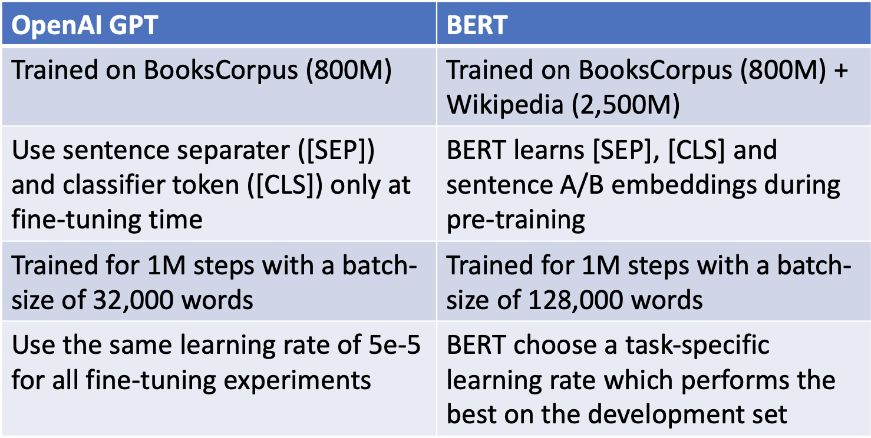
Comparison of BERT and OpenAI GPT

Slide 13
Experiments

Slide 14
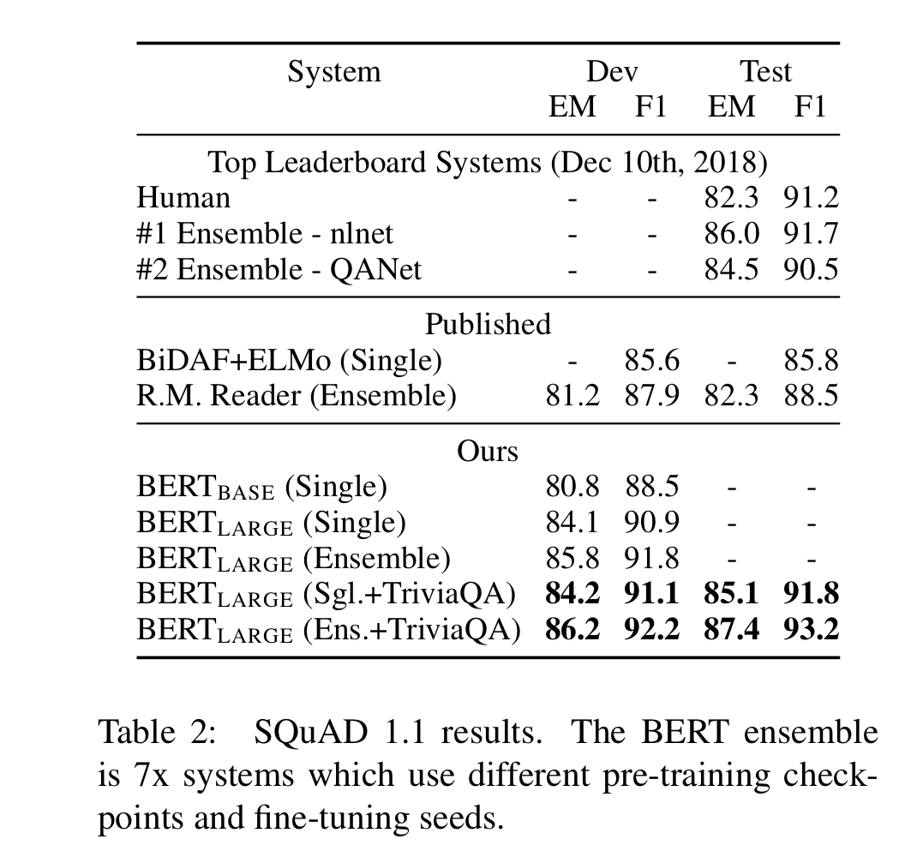
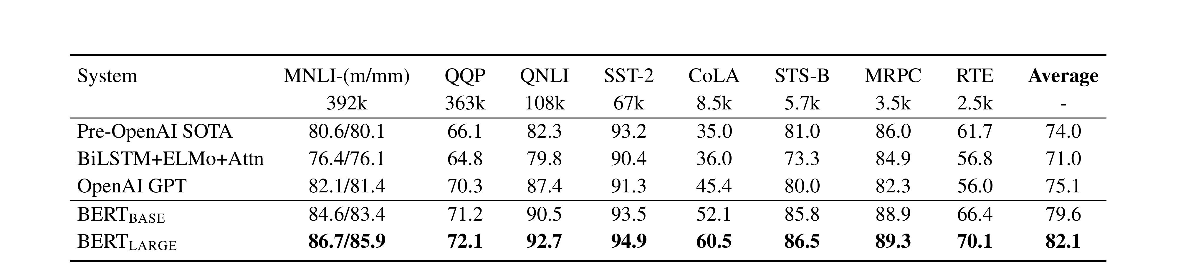
Experiments
GLUE - Includes many datasets - MNLI, QQP, QNLI etc.
Stanford Question Answering Dataset.
Notes:
GLUE – The General Language Understanding Evaluation benchmark
MNLI – Multi-Genre Natural Language Inference
QQP – Quora Question Pairs
QNLI – Question Natural Language Inference.
Bert-Base and Bert-Large outperform all systems on all tasks by a substantial margin, obtaining 4.5% and 7.0% respective average accuracy improvement over the prior state of the art.
For squad insert a [CLS] before question and a [SEP] between question and answer phrase
The probability of word i being the start word and word j being the end word of the answer span is computed

Slide 15
Ablation Studies
To Understand
Effect of Pre-Training Tasks
Effect of Model Sizes
Feature-based approach with BERT

Slide 16
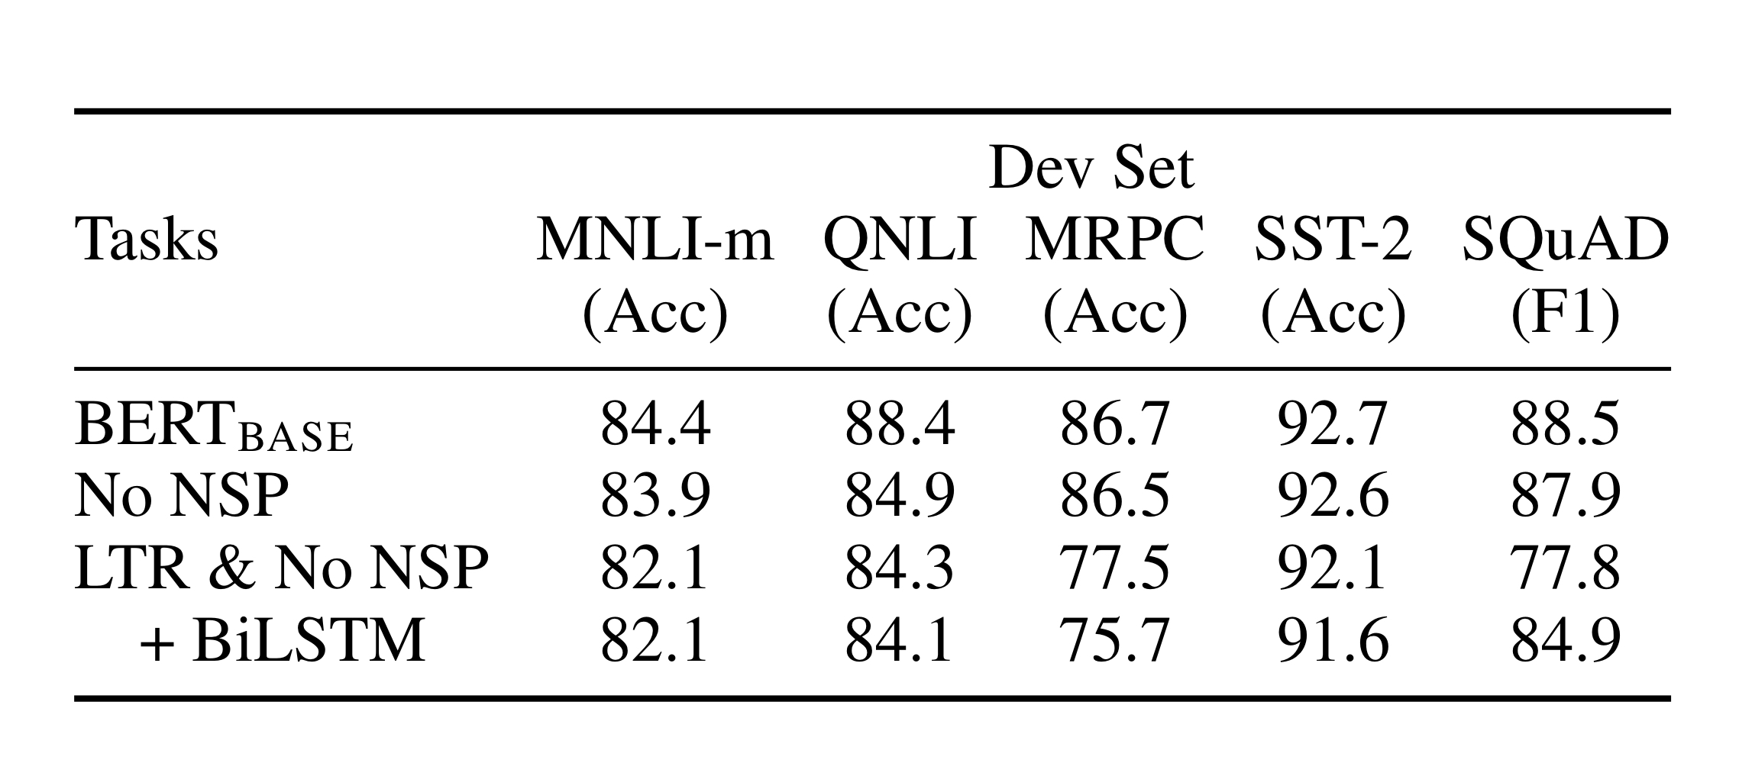
Effect of Pre-Training Tasks
Next Sentence Prediction (NSP) pre-training is important for sentence-pair classification task
Bidirectionality (using MLM) contributes significantly to the performance improvement.
Notes:
LTR- Left-to-right
Removing NSP hurts performance significantly on QNLI, MNLI and SQuAD 1.1
The LTR model performs worst than the MLM model on all tasks, with large drops on MRPC and SQuAD where for SQuAD it is intuitively clear why it performs worse since the token level hidden states have no right-side context.

Slide 17
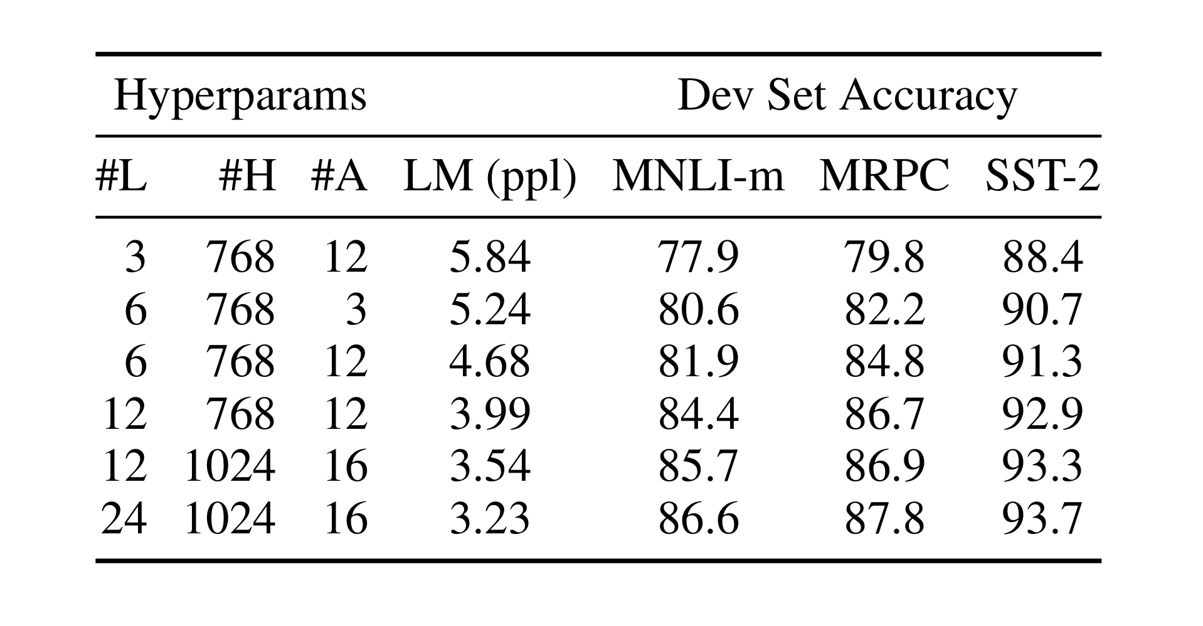
Effect of Model Size
Bigger Model sizes are better even for small scale tasks.

Slide 18
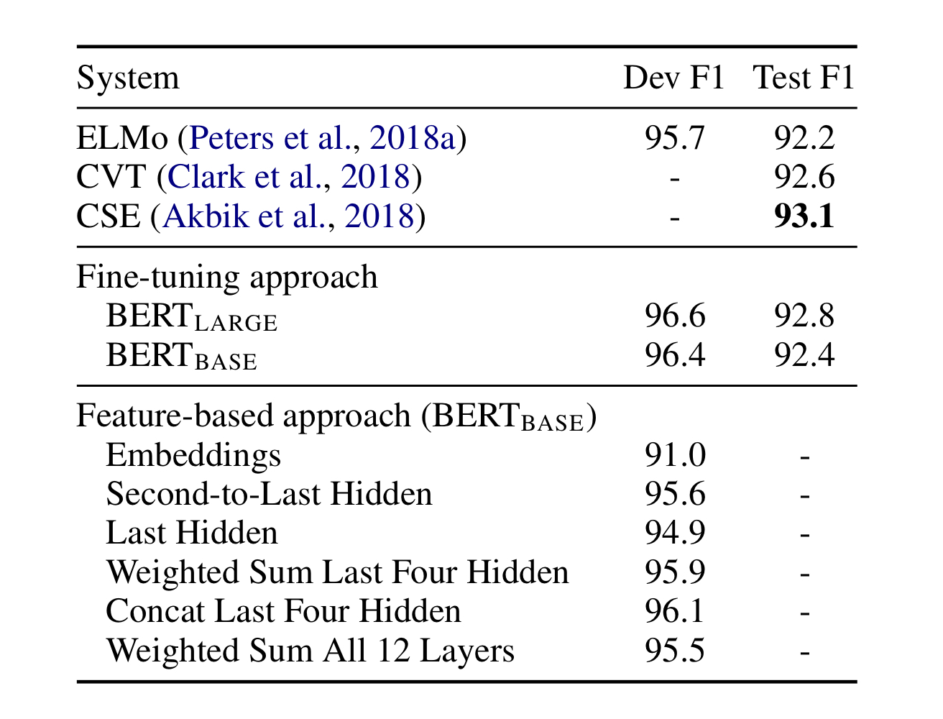
Feature-based Approach with BERT

Slide 19
Conclusion
Unsupervised pre-training (pre-training language model) is increasingly adopted in many NLP tasks.
Major contribution of the paper is to propose a deep bidirectional architecture from Transformer
Advance state-of-the-art for many important NLP tasks.

Slide 20
RoBERTa: A Robustly Optimized BERT Pretraining Approach Liu, Y. et al. (Facebook AI)
Angela Lee
CS 546: Machine Learning in NLP (Spring 2020)

Slide 21
What is RoBERTa?
Goal:
Replicate, simplify, and better tune the training of BERT
To better understand the relative performance of the various proposed pretraining methods for language modeling
Optimize BERT pretraining procedure with these main modifications:
Dynamic masking
No next sentence prediction objective
Training on longer sequences
Large mini-batches
Larger byte-level Byte-Pair Encoding (BPE)
Training the model longer

Slide 22
Datasets for Pretraining
BERT-style pretraining relies on large quantities of text
5 English-language corpora:
BookCorpus
Wikipedia
CC-News (63 million news articles)
OpenWebText (open-source recreation of the WebText corpus—content extracted from URLs shared on Reddit that had >= 3 upvotes)
Stories (subset of CommonCrawl data filtered to match the story-like style of Winograd schemas)

Slide 23
Training Procedure Experiments
Determining which choices are important for successfully pretraining BERT models
Note: fixed model architecture (same configuration as BERT_{BASE})

Slide 24
Static vs. Dynamic Masking
Masking: replacing a random sample of the tokens in the input sequence with [MASK] token
Static masking: perform masking once during data preprocessing
Note: data is duplicated 10 times so each sequence is masked in 10 different ways over 40 epochs of training
Dynamic masking: generate the masking pattern every time a sequence is fed to the model

Slide 25
Training Input Formats
Segment-pair + Next Sentence Prediction (NSP)
Each input has a pair of segments, which can each contain multiple sentences
Sentence-pair + NSP
Each input contains a pair of sentences (not necessarily contiguous)
Full-sentences
Each input has full sentences sampled contiguously from one or more documents
Doc-sentences
Each input has full sentences sampled contiguously from the same document
Findings
Using individual sentences (Sentence-pair) hurts performance on downstream tasks
Perhaps the model is not able to learn long-range dependencies
Removing the NSP loss matches or slightly improves downstream task performance
Doc-sentences performs slightly better than Full-sentences

Slide 26
Others
Training with a large batch sizes (8K) improves perplexity for the masked language model objective and end-task accuracy
Perplexity:
Using bytes instead of Unicode characters in Byte-Pair Encoding (BPE) results in slightly worse end-task performance on some tasks
But size of subword vocabulary makes it worth the tradeoff
Source on perplexity: https://www.coursera.org/lecture/language-processing/perplexity-is-our-model-surprised-with-a-real-text-hw9ZI

Slide 27
Hyperparameters

Slide 28
Results on Dataset Size and Training Time
Key Takeaways:
RoBERTa provides a large improvement over the BERT_{LARGE} results, reaffirming the importance of the design choices
Adding more data (and increasing diversity) improves performance
Pretraining RoBERTa for a larger number of steps results in better performance than state-of-the-art competitors

Slide 29
Benchmark Evaluation
GLUE: General Language Understanding Evaluation
SQuAD: Stanford Question Answering Dataset
RACE: ReAding Comprehension from Examinations

Slide 30
GLUE Finetuning
Finetuning setting #1: (single-task, dev)
Finetuning setting #2: (ensembles, test)
Compare RoBERTa to other approaches on the test set via the GLUE leaderboard
Depends only on single-task finetuning, unlike many other submissions
Ensemble 5-7 single-task models per task

Slide 31
GLUE Results
RoBERTa is the winner of all 9 tasks of the first setting (task development sets)
Note: RoBERTa uses the same masked language modeling pretraining objective and architecture as BERT_{LARGE}
Raises questions about relative importance of model architecture and pretraining objective vs. details such as dataset size and training time
RoBERTa achieves the highest average score in the test setting
Particularly exciting since it does not depend on multi-task finetuning

Slide 32
SQuAD Finetuning and Results
RoBERTa is only finetuned using the provided SQuAD training data
(BERT and XL-Net augment their training data with additional QA datasets)
Same learning rate for all layers
(XLNet has a custom layer-wise learning rate schedule)
For SQuAD v1.1, same finetuning procedure as original BERT paper
For SQuAD v2.0, additionally classify whether a given question is answerable; train this classifier jointly with the span predictor

Slide 33
RACE Finetuning and Results
In RACE, systems are given a passage of text, an associated question, and 4 candidate answers; objective is to choose which is correct
Modify RoBERTa by:
Concatenating each candidate answer with the corresponding question and passage
Encoding each of these 4 sequences
Passing the resulting [CLS] representations through a fully-connected layer to predict the correct answer

Slide 34
Summary of Key Contributions
Found that performance can be substantially improved through:
Longer pretraining time
Bigger batches over more data
Longer sequences for training
Dynamically changing the masking pattern applied to training data
Collected a large new dataset (CC-News) to confirm that using more data for pretraining further improves downstream task performance
Achieved state-of-the-art results on GLUE, RACE, and SQuAD
Without multi-task finetuning for GLUE or additional data for SQuAD
Demonstrated the importance of previously overlooked design decisions/hyperparameters
BERT was significantly undertrained, and can match or exceed the performance of every model published after it

Slide 35
GPT2: Language Models are Unsupervised Multitask Learners
By Alec Radford et al, OpenAI
Presented by
Vikram Sharma Mailthody
CS546: Machine Learning in NLP (Spring 2020)
Notes:
How to us gpt2

Slide 36

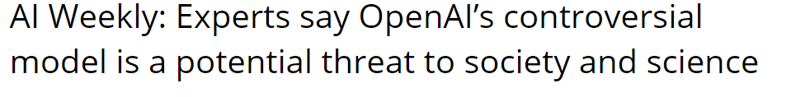
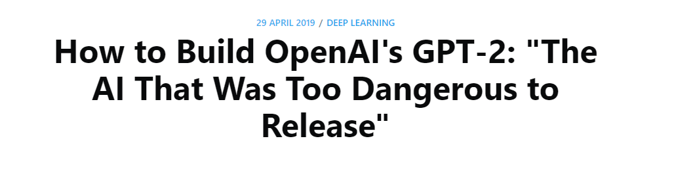
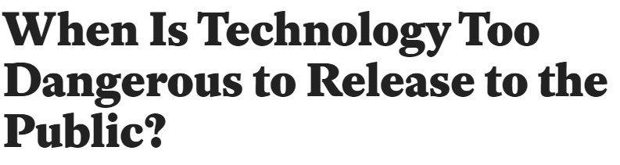

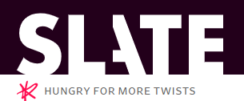
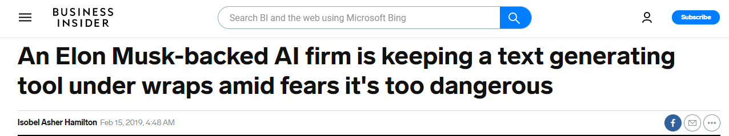
Controversy and Demo
https://talktotransformer.com/
Notes:
CS546 is an awesome class where we learn about Machine learning in Natural Language Processing

Slide 37
GPT2 Applications
Language model
Autocomplete texts - https://transformer.huggingface.co/doc/gpt2-large
Question and answering
Summarization – Project idea – why not auto-create paper abstracts?
Auto code completion - https://tabnine.com/
Code generation
Reading comprehension
Translation
Commonsense reasoning
…

Slide 38
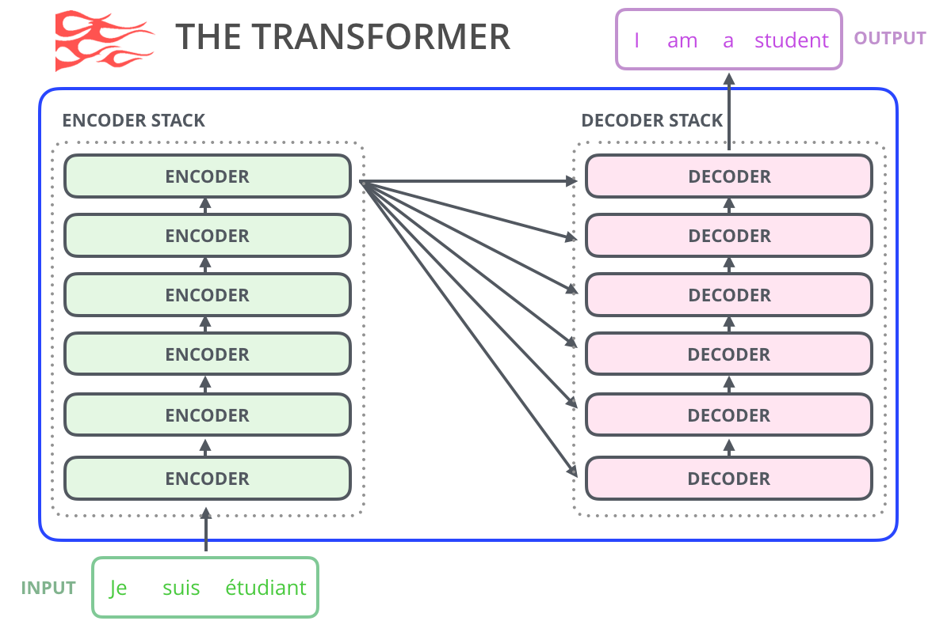
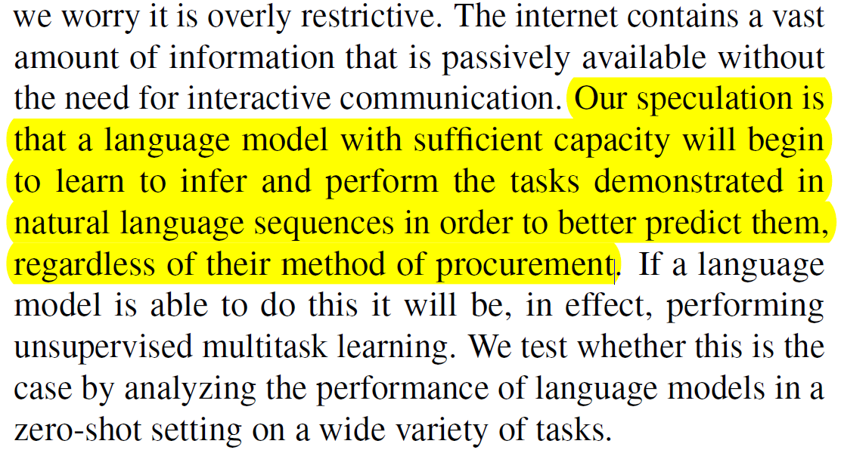
What is GPT2
http://jalammar.github.io/illustrated-gpt2/
It is just decoder only Transformer model but very LARGE
Outputs 1 token at a time → becomes input → auto regression.
Training was the key!

Slide 39
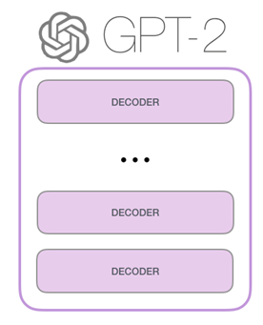
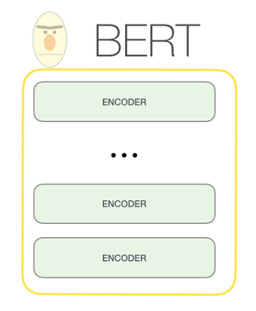
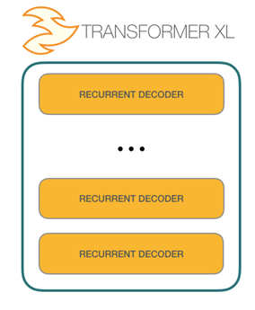
Compare to BERT, TransformerXL
BERT uses encoder part of Transformer and is not auto regressive.
BERT incorporates context on both sides of word to gain better results.
TransformerXL = BERT+ Autoregression
http://jalammar.github.io/illustrated-gpt2/

Slide 40
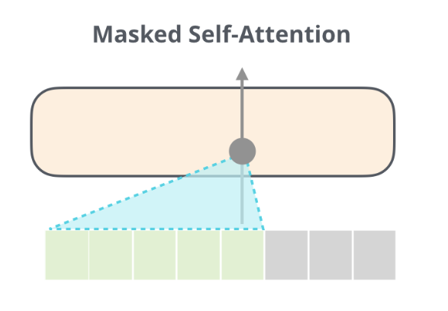
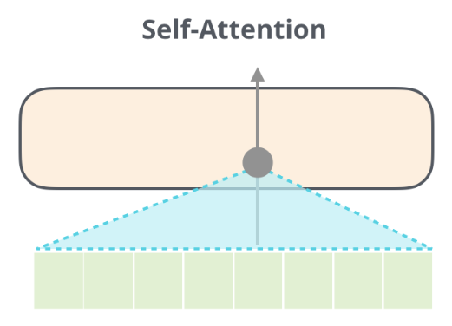
GPT2 Model – 1 layer
Feed Forward Layer with GELU
ADD+NORM
Masked Self-Attention
(multi head, head=16)
ADD+NORM
https://github.com/openai/gpt-2/blob/master/src/model.py#L123

Slide 41
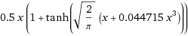
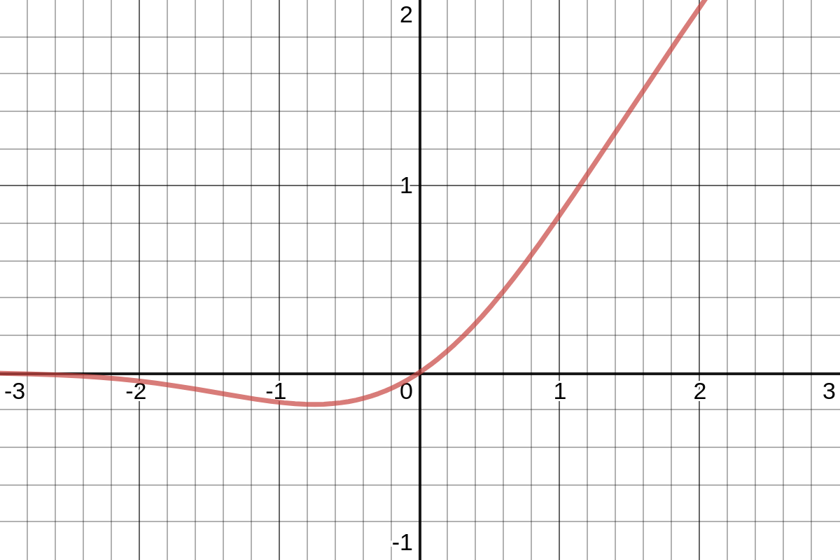
Introducing Gelu
https://www.wolframalpha.com/ and https://github.com/openai/gpt-2/blob/master/src/model.py#L25

Slide 42
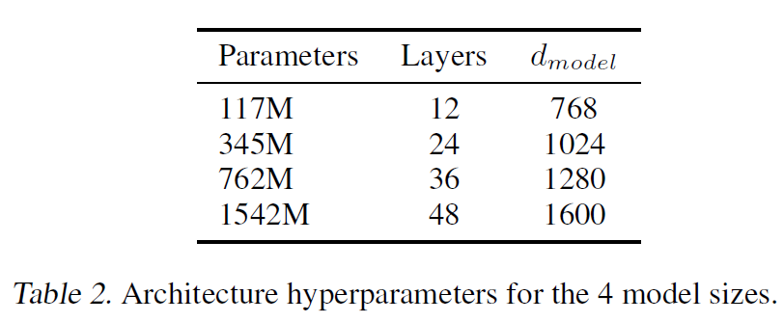
Training and Bag of Tricks
1) Dataset – Need large dataset
Common Crawl – unintelligible
New data– WebText based on Reddit
Emphasis on document
Removed all Wikipedia data – avoid data overlaps
45million links, 8 million documents, 40GB of text
2) Input Representation
Byte-Pair encoding
No lossy preprocessing or tokenization
Vocab size : 50257
Batch size : 512 and 1024 tokens
Param | Config
Seq length | 1024
Train iteration | 320000
Learning rate | 1.5e⁻⁴
Decay style | Cosine
Weight decay | 1e-2
Typical numbers used in GPT2 training

Slide 43
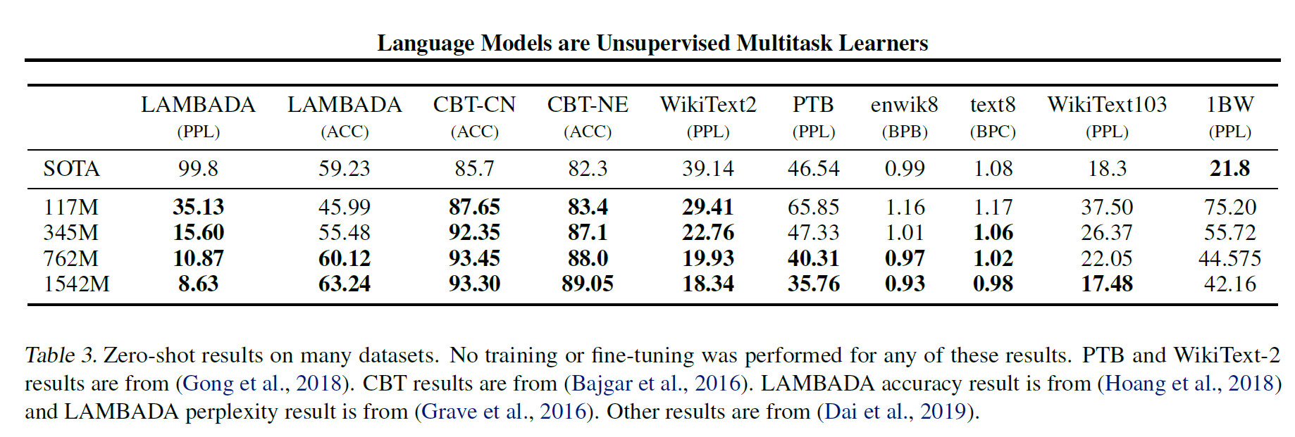
Result
LAMBADA: Long range dependency evaluation
CBT: Automatically predict which of the 10 omitted word is correct

Slide 44
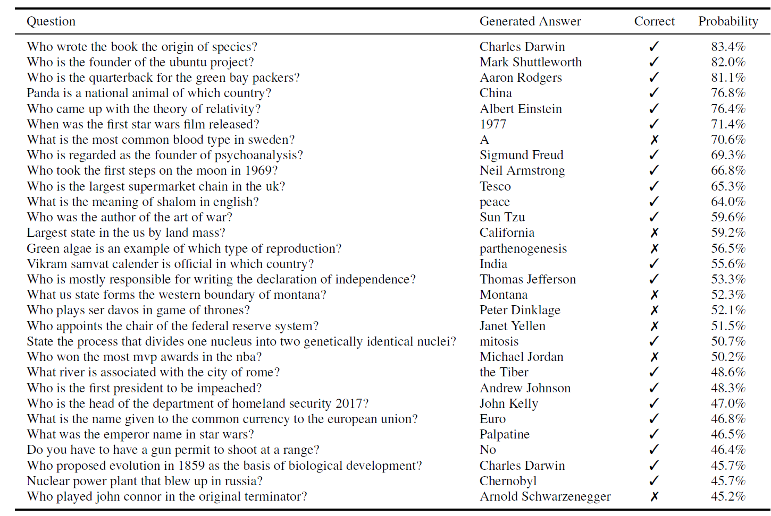
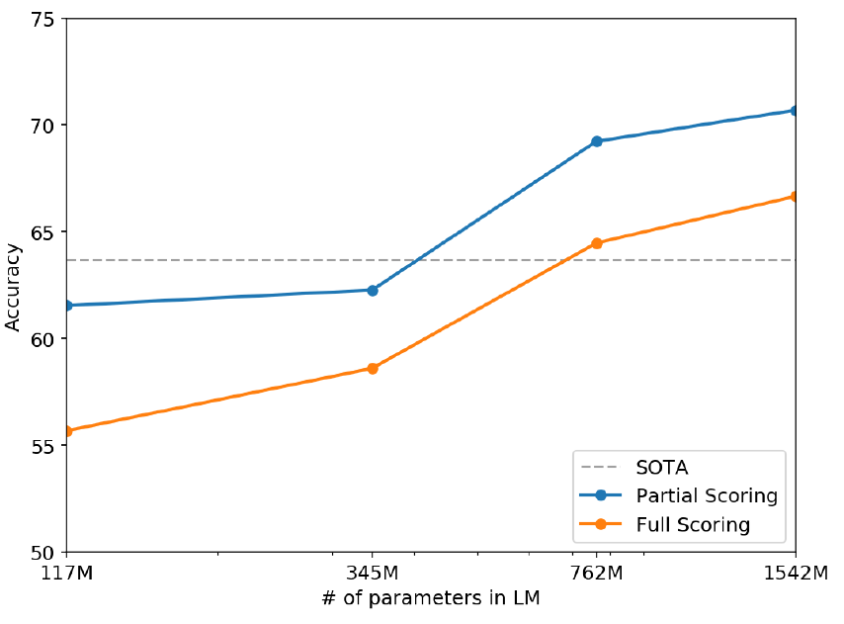
Result
Winograd Scheme
(commonsense reasoning)
Q and A

Slide 45
Discussion
Large stack of “Attention is all you need”:
Megatron-LM (8.9B params) and Turing-NLG (17B params)
“Training data” matters significantly!
Training time is huge – system designer need to create optimizers
Sparse Transformers study is currently sparse!
So many questions:
Bias introduction?
Relu clipping – RELU5/RELU6 – why not GELU clipping? What's the impact?
What if I skip some layers like Resnet?
…

Slide 46
Links
https://talktotransformer.com/
https://transformer.huggingface.co/doc/gpt2-large
https://github.com/openai/gpt-2/blob/master/src/model.py
Must Read: http://jalammar.github.io/illustrated-gpt2/
GPT2 Playground: https://colab.research.google.com/github/ilopezfr/gpt-2/blob/master/gpt-2-playground_.ipynb

Slide 47
Backup

Slide 48

Transformer-XL
Zhiqian Zhou

Slide 49
Transformer-XL
Attentive Language Models Beyond a Fixed-Length Context
a segment-level recurrence mechanism
a novel positional encoding scheme
Outperform state-of-the-art on capturing long-term dependency and speed of evaluation
Transformer-XL learns dependency that is 80% longer than RNNs and 450% longer than vanilla Transformers

Slide 50
Why Transformer-XL?
To apply Transformer to language modeling, the central problem is how to encode an arbitrarily long context into a fixed size representation
Process the entire context sequence (chunking a sequence into fixed-length segments)
Or, Transformer-XL!

Slide 51
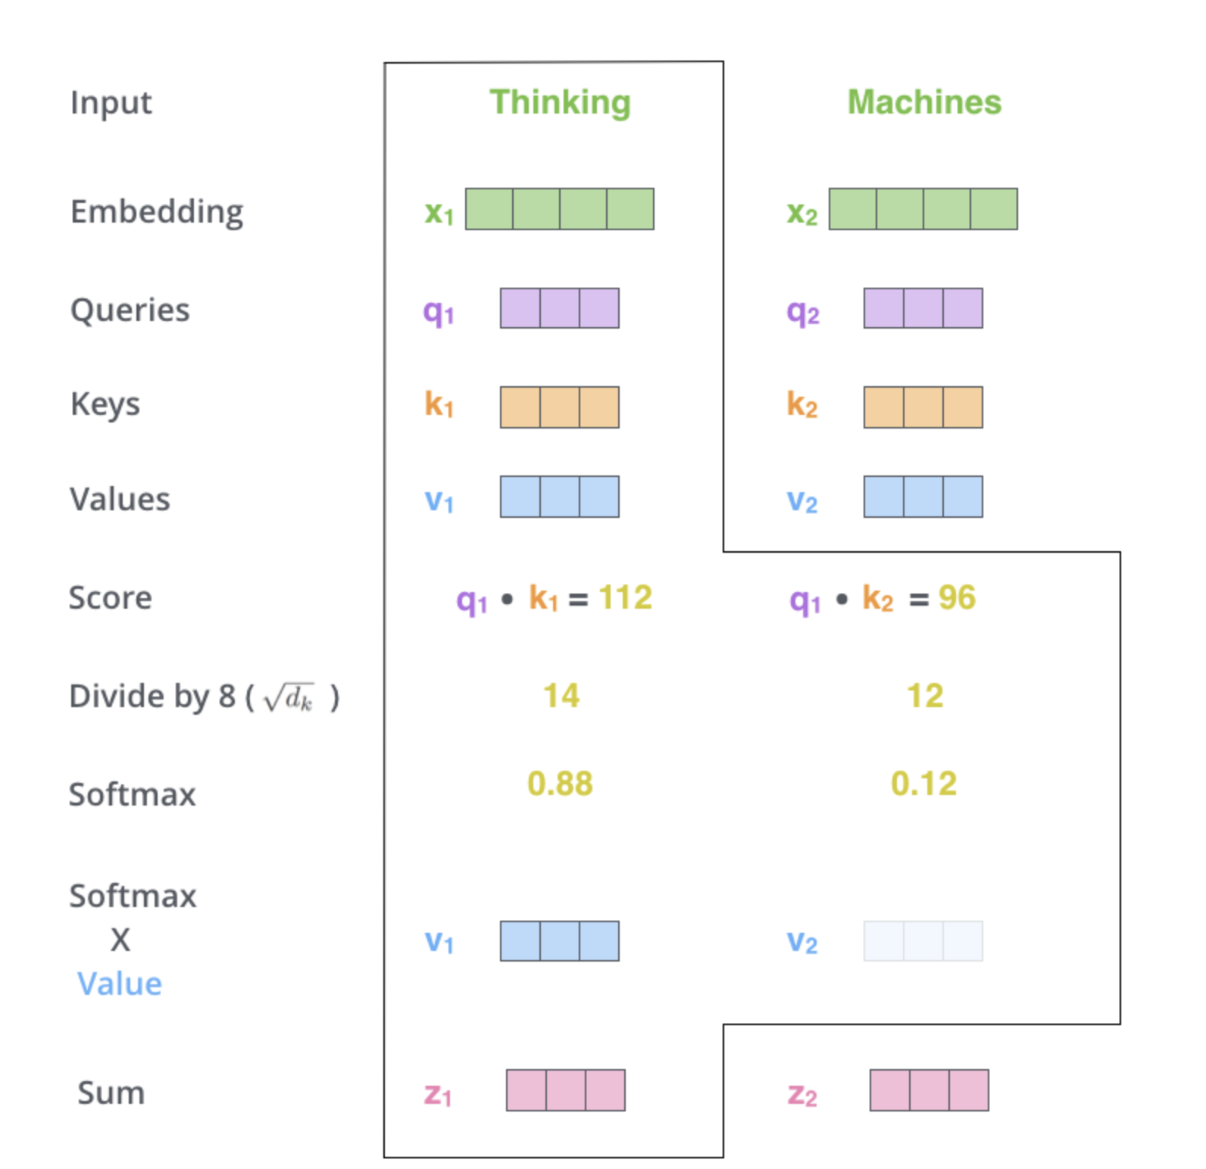
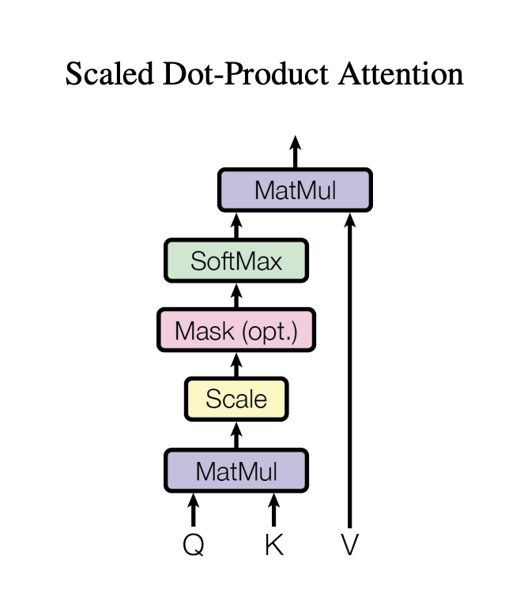
Vanilla Transformer
Notes:
Explain Q, K and V. Mention fix length input.
dot product of the query vector with the key vector of the respective word we’re scoring
Mask: We need to prevent leftward information flow in the decoder to preserve the auto-regressive property.

Slide 52
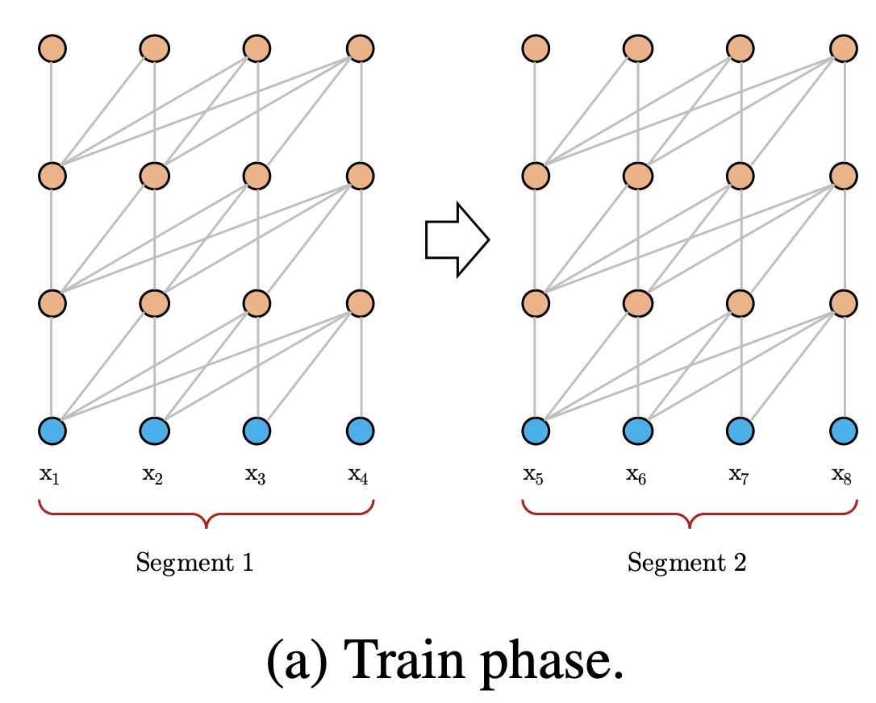
Vanilla Transformer
Split the entire corpus into shorter segments of manageable sizes, and only train the model within each segment, ignoring all contextual information from previous segments.
Drawback:
The largest possible dependency length is upper bounded by the segment length
Chunking a sequence into fixed-length segments will lead to the context fragmentation problem (lacking necessary contextual information )
Notes:
Fix length segment. Length 4 and 4 layers.

Slide 53
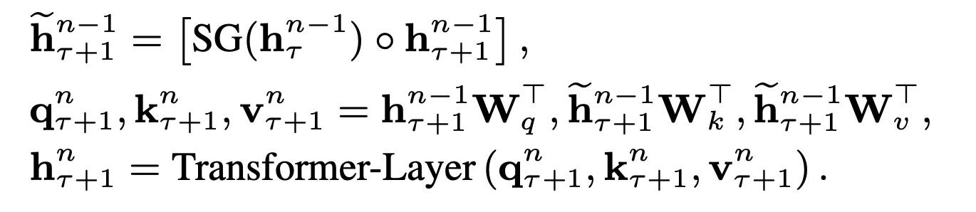
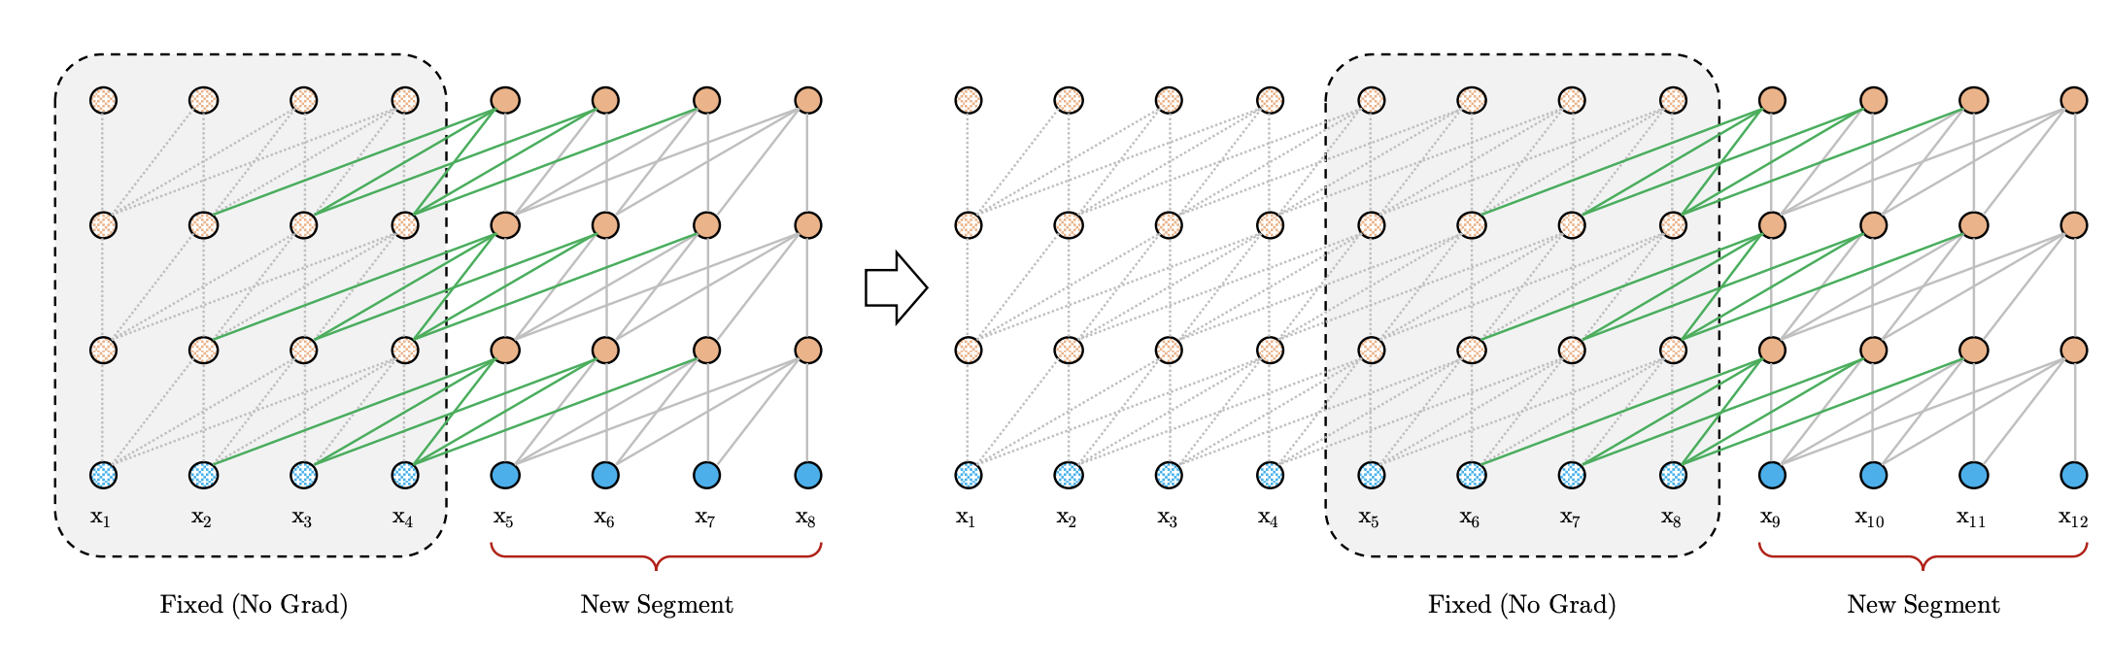
Transformer-XL
Stop- Gradient
n-th layer
Concatenate
τ –th segment
Hidden state as extended context
Notes:
the hidden state sequence computed for the previous segment is fixed and cached to be reused as an extended context

Slide 54
Hidden Context State Advantage
Achieving extra long context and resolving fragmentation
Evaluation process is speedup significantly
Recurrence scheme does not need to be restricted to only the previous segment
Notes:
In theory, we can cache as many previous segments as the GPU memory allows, and reuse all of them as the extra context when processing the current segment.

Slide 55
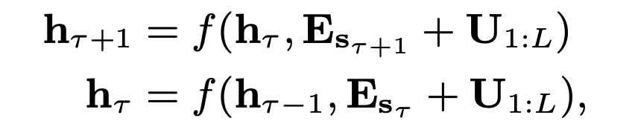
Transformer-XL
How to keep the positional information coherent when we reuse the hidden states?
Word Embedding Sequence
How to distinguish?
Token Sequence in τ –th segment
Positional Encodings
Positional encoding gives the model a temporal clue or “bias” about how information should be gathered, i.e., where to attend.
Notes:
i-th row Ui corresponds to the i-th absolute position within a segment
Input: element-wise addition of the word embeddings and the positional encodings
What about multiple previous segment?
f(): transformation function

Slide 56
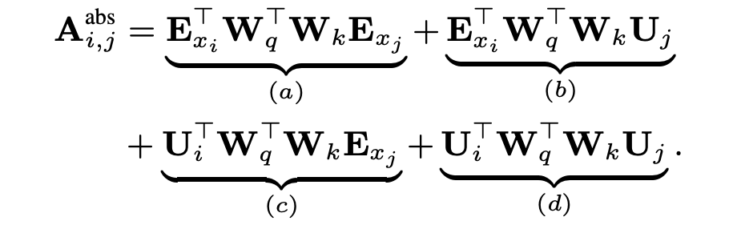
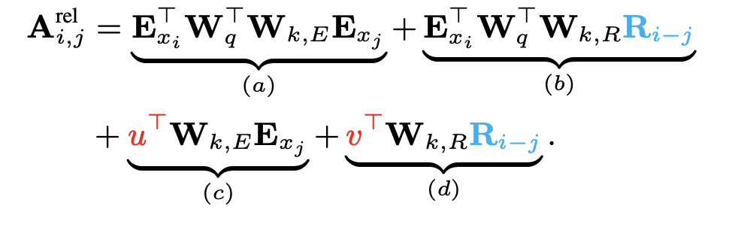
Transformer-XL
Instead of incorporating position into the initial embedding, it can inject the same information into the attention score of each layer.
Absolute position -> Relative position
trainable parameter
query vector
Standard Transformer
Transformer-XL
Notes:
since the query vector is the same for all query positions, it suggests that the attentive bias towards different words should remain the same regardless of the query position
term (a) represents content-based addressing, term (b) captures a content-dependent positional bias, term (c) governs a global content bias, and (d) encodes a global positional bias

Slide 57
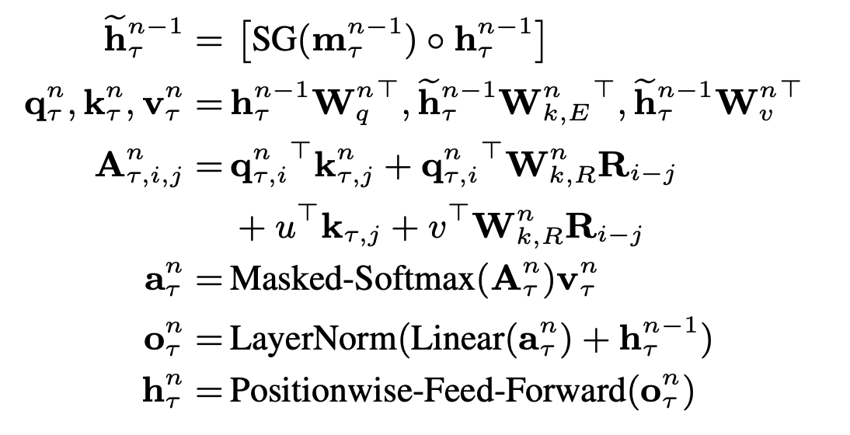
Transformer-XL Architecture
New hidden state with context from previous segment
Absolute Position -> Relative Position

Slide 58
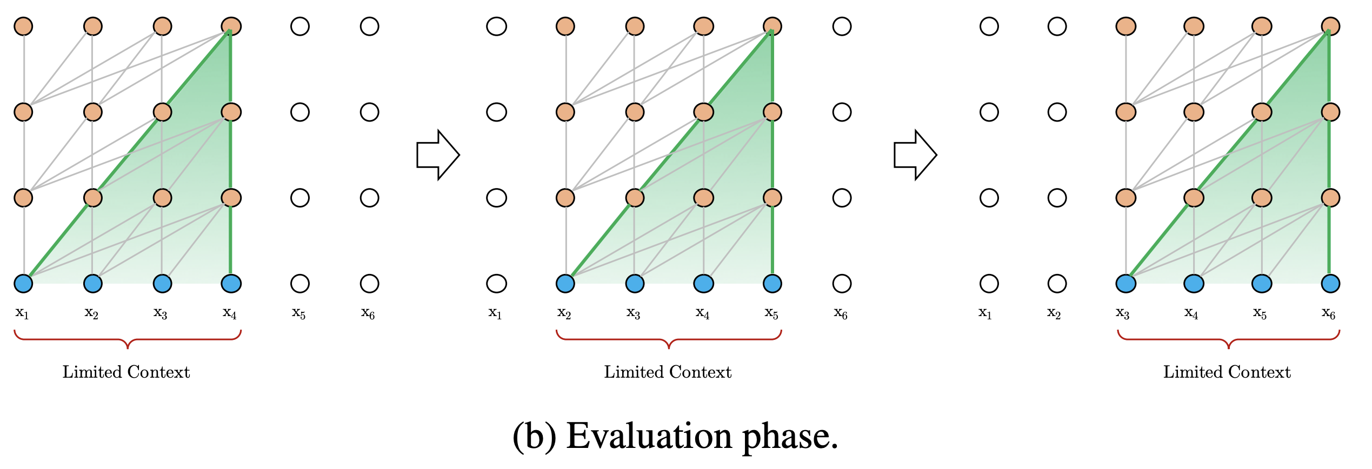
Vanilla Transformer vs Transformer-XL
Extremely Expensive!!!
This procedure ensures that each prediction utilizes the longest possible context exposed during training, and also relieves context fragmentation issue encountered in training.
Vanilla Transformer

Slide 59
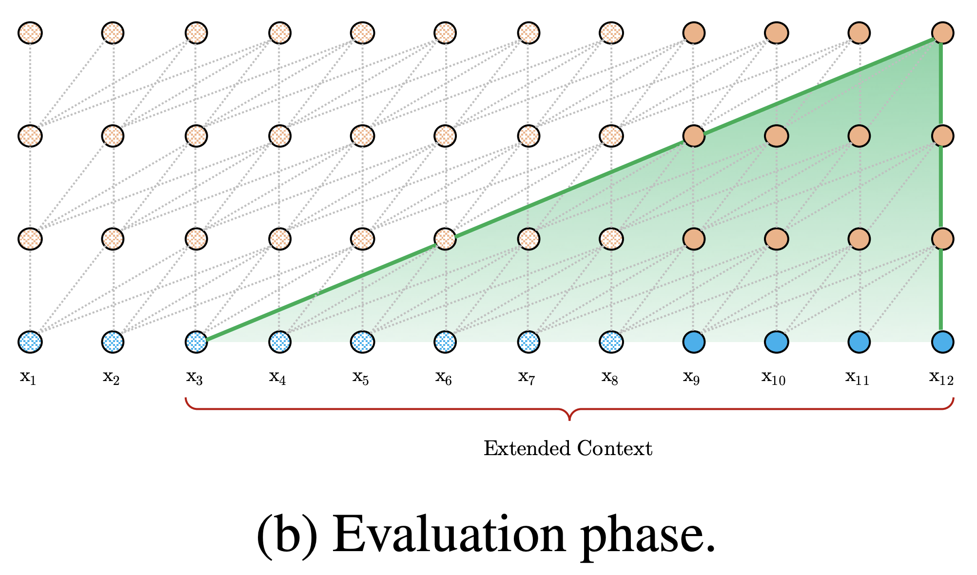
Vanilla Transformer vs Transformer-XL
The largest possible dependency length grows linearly with respect to the number of layers as well as the segment length
Transformer-XL

Slide 60
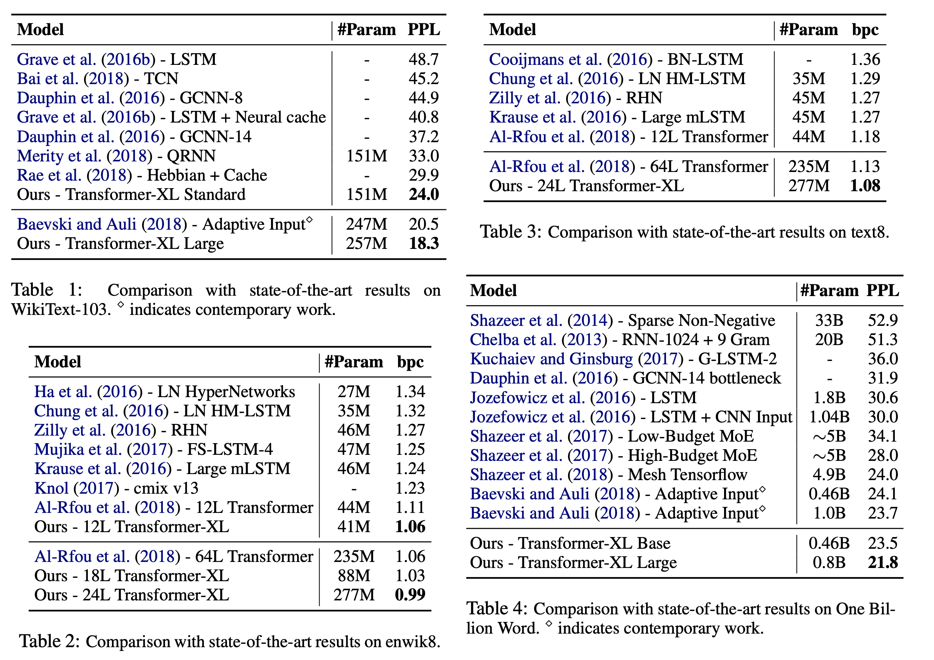
Result
word-level
character-level

Slide 61
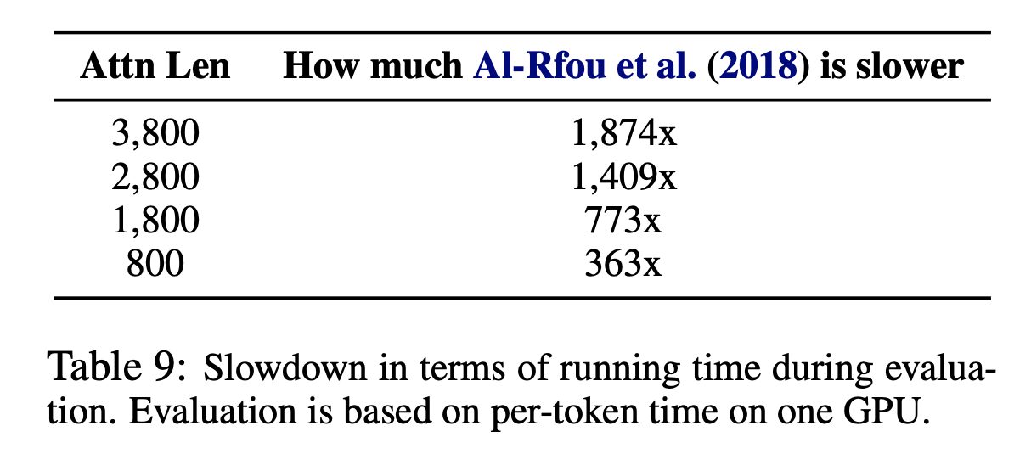
Result
Vanilla Transformer
Speed of Evaluation

Slide 62
Application
Text Generation
Unsupervised Feature Learning
Image and Speech Modeling

Slide 63
References
Dai, Z., Yang, Z., Yang, Y., Carbonell, J., Le, Q. V., & Salakhutdinov, R. (2019). Transformer-xl: Attentive language models beyond a fixed-length context. arXiv preprint arXiv:1901.02860.
Al-Rfou, R., Choe, D., Constant, N., Guo, M., & Jones, L. (2019, July). Character-level language modeling with deeper self-attention. In Proceedings of the AAAI Conference on Artificial Intelligence (Vol. 33, pp. 3159-3166).
Vaswani, A., Shazeer, N., Parmar, N., Uszkoreit, J., Jones, L., Gomez, A. N., ... & Polosukhin, I. (2017). Attention is all you need. In Advances in neural information processing systems (pp. 5998-6008).
Alammar, J. (2018). The Illustrated Transformer [Blog post]. Retrieved from https://jalammar.github.io/illustrated-transformer/

Slide 64
XLNet
Generalizing Autoregressive Pretraining for Language Understanding
Zhilin Yang, et. al.
By Charlotte Yoder
Spring 2020, CS546

Slide 65
Outline
Motivation for XLNet
XLNet Basics
XLNet In-depth
Experiments
Conclusions

Slide 66
Motivation
Cons of BERT
Masks don’t appear in fine-tuning and create artificial noise
Tokens predicted in parallel – lose interdependence
Cons of Transformer – XL
Target position is ambiguous
Notes:
While BERT achieved a lot by using bidirectional encoding, it lost the interdependence of words

Slide 67
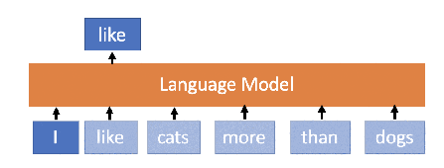
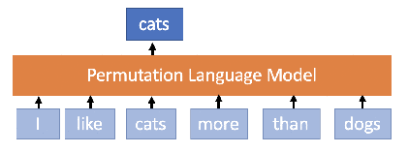
XLNet Basics
Autoregressive model that has bidirectional context
Random prediction of tokens instead of masking
Learns dependencies between all words
Predicts in any order
Notes:
Take the example I like cats more than dogs
BERT vs. XLNet
The distribution of the first word in the sentence varies widely from a word that is in the middle of a sentence

Slide 68
Factorization Order
”cats” -> “I” -> ”more” -> “dogs” -> “than” -> “like”
I
h1
I
like
cats
more
than
dogs

Slide 69
Factorization Order
”cats” -> “I” -> ”more” -> “dogs” -> “than” -> “like”
more
h2
I
like
cats
more
than
dogs

Slide 70
Factorization Order
”cats” -> “I” -> ”more” -> “dogs” -> “than” -> “like”
dogs
h3
I
like
cats
more
than
dogs

Slide 71
Factorization Order
”cats” -> “I” -> ”more” -> “dogs” -> “than” -> “like”
like
h3
I
like
cats
more
than
dogs

Slide 72
Target Position Aware
”cats” -> “I” -> ”more” -> “dogs” -> “than” -> “like”
”cats” -> “I” -> “than” -> “dogs” -> “more” -> “like”
Distribution for predicting ”more” is different from predicting “than”
more
than
h2
h2
I
like
cats
more
than
I
like
cats
more
than
…
…

Slide 73
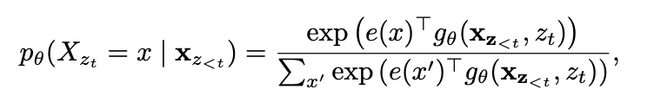
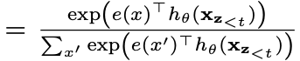
Parameterization
Want the next token distribution to be target position aware
Standard softmax -> representation of position (z_{t})
Notes:
Want the likelihood to include the position in the sentence without including what the word is

Slide 74
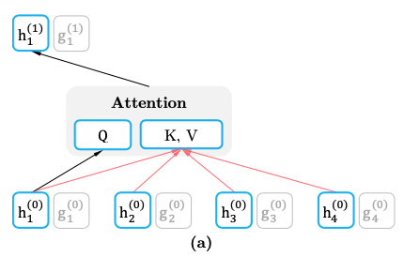
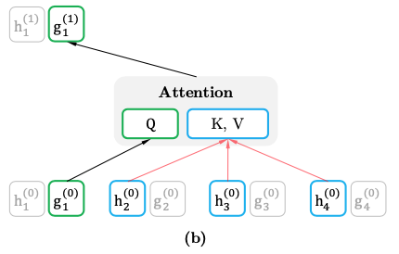
Two-Stream Self-Attention
Need to encode self when not predicting self
Gather information about previous tokens while using information about current token

Slide 75
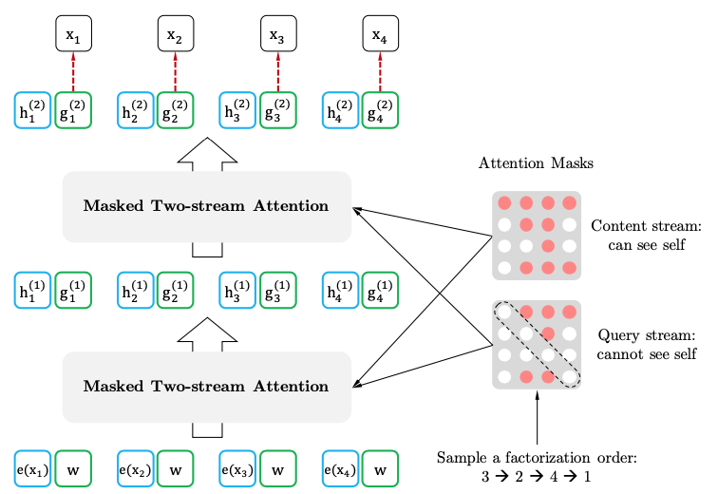
Two-Stream Self-Attention

Slide 76
Two-Stream Self-Attention: Example
more
h2
g_{zt}
I
like
cats
more
than
dogs

Slide 77
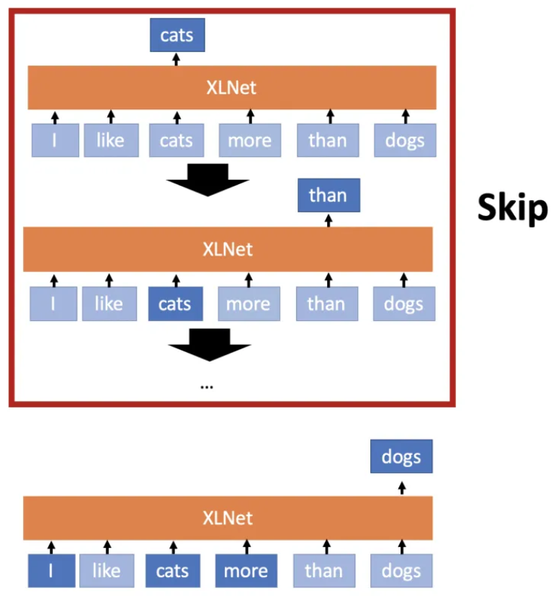
Optimization difficulty
Converges slowly because permutation is more challenging
Look at the last few words of the sentence instead of the whole sentence

Slide 78
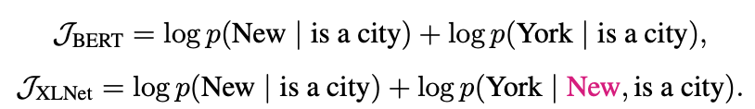
Comparison: New York is a City
BERT captures dependencies between (New, city) and (York, city)
XLNet captures the dependency between (New, York)
Has denser training vectors

Slide 79
Multiple Segments Modeling
Learn an embedding that shows if words are from the same segment
Similar to attention encoding in Transformer-XL
Use special tokens to delimit the input sequence
Allows for an arbitrary number of sequences as input

Slide 80
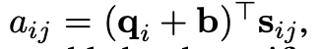
Relative Segments Modeling
Given a pair of positions i and j only see if they are from the same segment
a_{ij} is added to the attention weight
Where s_{ij} is the segment encoding, q_{i} is the query vector, b is a bias-vector
Improves generalization
Allows for fine-tuning on tasks with more than two input segments

Slide 81
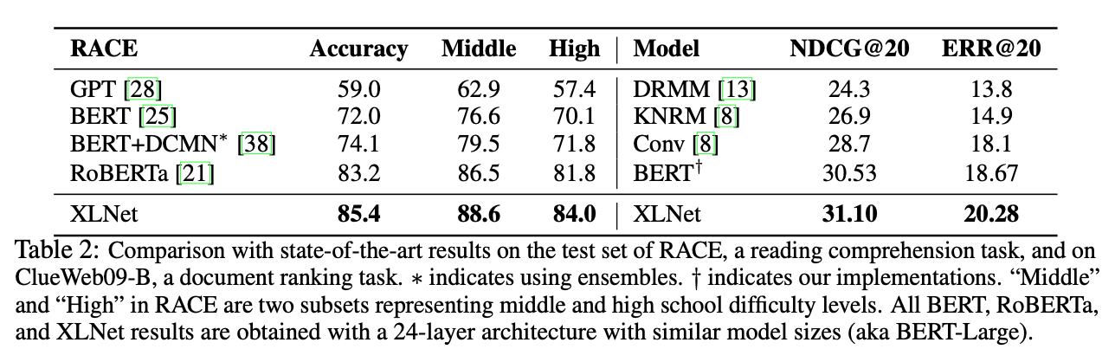
Experiments
Longer context got better results

Slide 82
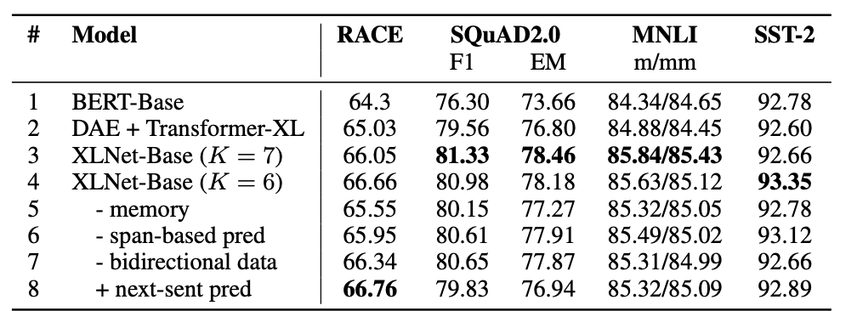
Why did XLNet perform better?
Notes:
Using permutation modeling and transformer architecture caused XLNet to succeed

Slide 83
Conclusion
XLNet used language permutation to combine autoencoding and autoregression in pretraining.
It bypassed the current-state-of-the-art models’ scores on various tasks
reading comprehension & document ranking
question answering
text classification
etc.

Slide 84
References
[1] https://mlexplained.com/2019/06/30/paper-dissected-xlnet-generalized-autoregressive-pretraining-for-language-understanding-explained/
[2] https://github.com/zihangdai/xlnet/blob/master/misc/slides.pdf

